Slide 1
SQL Lesson 5a
Select Statement
V1.0 2020

Slide 2
Lesson Objectives
After completing this lesson you will be able to
Run the basic SELECT statement
Use Arithmetic Expressions
Understand nulls
Use column aliases
Concatenate columns and display literals
Use DISTINCT keyword to remove duplicate output rows
Run the DESCRIBE SQL Developer command to list a table’s columns and datatypes

Slide 3
Select statement
Basic select statement
Math expressions
Nulls
Column aliases
Concatenation and literals
Remove duplicate rows
Describe command

Slide 4
Basic SELECT statement
The SELECT statement retrieves data stored in tables
You must specify the columns and tables where the data is stored
Here is a shorthand of the SELECT statement. | means or
SELECT * | column1, column 2, etc
FROM table_name;
SELECT and FROM clauses are required
SQL is case insensitive

Slide 5
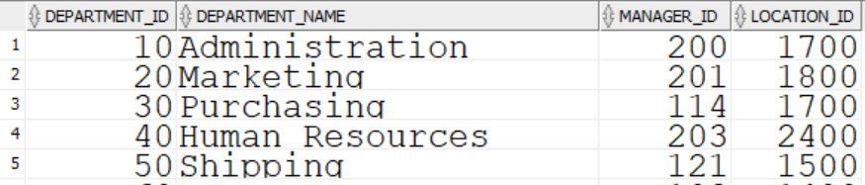
Basic SELECT statement
Use * to SELECT all columns.
All rows will be displayed.
SELECT *
FROM departments;
…

Slide 6
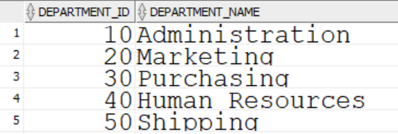
Basic SELECT statement
SELECT specific columns
SELECT department_id, department_name
FROM departments;
…

Slide 7
Basic SELECT Statement
Best practices
SELECT column1, column2
FROM table_name;
Keywords should be UPPER CASE
Each clause should begin on a new line
Indent subordinate clauses
End SQL statements with ;

Slide 8
Basic SELECT Statement
Best practices
/* The following SELECT statement
is very simple. */
SELECT last_name -- one column only
FROM employees;
-- Next we will see another example
Add comments as needed
Anything to the right of -- is considered a comment
/* and */ surround multi-line comments

Slide 9
Select statement
Basic select statement
Math expressions
Nulls
Column aliases
Concatenation and literals
Remove duplicate rows
Describe command

Slide 10
Math expressions
Math expressions with Number and Date data use the following operators
Operator | Description
+ | Add
- | Subtract
* | Multiply
/ | Divide

Slide 11
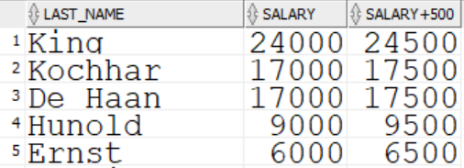
Math expressions
SELECT last_name, salary, salary + 500
FROM employees;
…

Slide 12
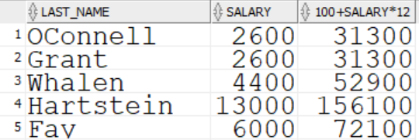
Math expressions
Operator precedence
SELECT last_name, salary, 100 + salary * 12
FROM employees;
…

Slide 13
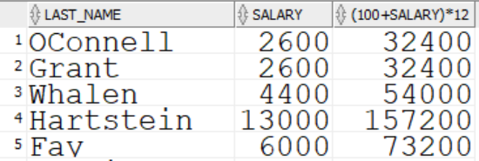
Math expressions
Operator precedence
SELECT last_name, salary, (100 + salary) * 12
FROM employees;
…

Slide 14
Select statement
Basic select statement
Math expressions
Nulls
Column aliases
Concatenation and literals
Remove duplicate rows
Describe command

Slide 15
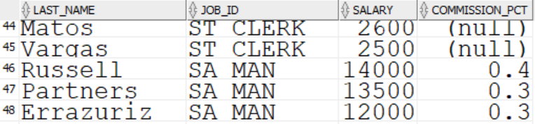
Nulls
If a row is missing a value in a column, this lack of a value is said to be a null.
Nulls are values that are unassigned, unavailable, unknown, and inapplicable
A null is not the same as a space or a zero
SELECT last_name, job_id, salary, commission_pct
FROM employees;
…

Slide 16
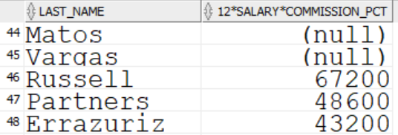
Nulls
Math expressions performed on nulls evaluate to null
SELECT last_name, 12 * salary * commission_pct
FROM employees;
…

Slide 17
Select statement
Basic select statement
Math expressions
Nulls
Column aliases
Concatenation and literals
Remove duplicate rows
Describe command

Slide 18
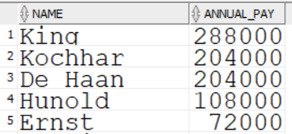
Column aliases
Renames a column heading in the output result
Is useful with calculations
Immediately follows the column name
Use the keyword AS.
SELECT last_name AS name, salary * 12 AS annual_pay
FROM employees;
…

Slide 19
Select statement
Basic select statement
Math expressions
Nulls
Column aliases
Concatenation and literals
Remove duplicate rows
Describe command

Slide 20
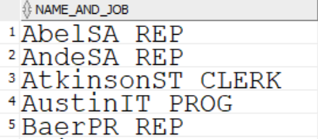
Concatenation
|| is the concatenation operator
It will abut columns and/or character strings
The resultant column is a character expression
SELECT last_name || job_id AS name_and_job
FROM employees;
…

Slide 21
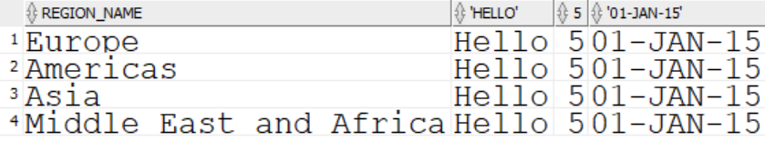
Literal values
A literal value is a hard-coded character, number, or date value
Character and date values must be enclosed in single quotes
Each literal value is returned once for each output row
SELECT region_name, ‘Hello’, 5, ‘01-JAN—15’
FROM regions;

Slide 22
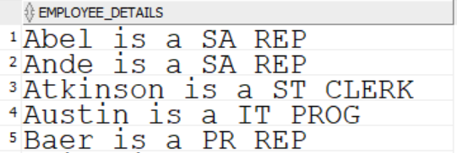
Concatenation and literal values
Columns are often concatenated with literal values
SELECT last_name || ‘ is a ‘ || job_id AS employee_details
FROM employees;
…

Slide 23
Select statement
Basic select statement
Math expressions
Nulls
Column aliases
Concatenation and literals
Remove duplicate rows
Describe command

Slide 24
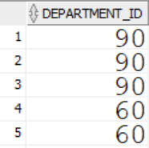
Remove Duplicate Rows
Sometimes, duplicated rows need to be removed from the output
SELECT department_id
FROM employees;
…

Slide 25
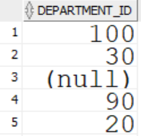
Remove Duplicate Rows
The DISTINCT keyword removes duplicate rows of output
SELECT DISTINCT department_id
FROM employees;
…

Slide 26
Select statement
Basic select statement
Math expressions
Nulls
Column aliases
Concatenation and literals
Remove duplicate rows
Describe command

Slide 27
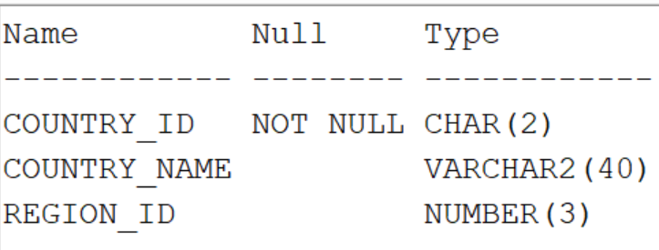
Describe Command
There may be times when you need to know the names of table columns in a non-gui environment
SELECT * from table_name; may not be practical if the query uses too many resources and/or takes too long to run
The DESC, or DESCRIBE Oracle tool command will display a table’s structure
; is not needed because DESC, or DESCRIBE, is not sql
DESC countries

Slide 28
Quiz
True or false?
The SELECT statement allows you to change data in tables
At a minimum, the optimizer needs to know which table and which rows you want to see data from
A null is a space
A column alias is an output column heading of your choice
The concatenation operator allows you to display two pieces of data end to end
Output rows can be de-duplicated using the extract keyword

Slide 29
Review
In this lesson you learned how to
Run the basic SELECT statement
Use Arithmetic Expressions
Understand nulls
Use column aliases
Concatenate columns and display literals
Use DISTINCT keyword to de-duplicate output rows
Run the DESCRIBE Oracle tool command to list a table’s columns and datatypes

Slide 30
Questions?

